Slide 1
ChemCorp Inc. Data Analysis
Dustin Na

Slide 2

Understanding the Market Segment

Slide 3
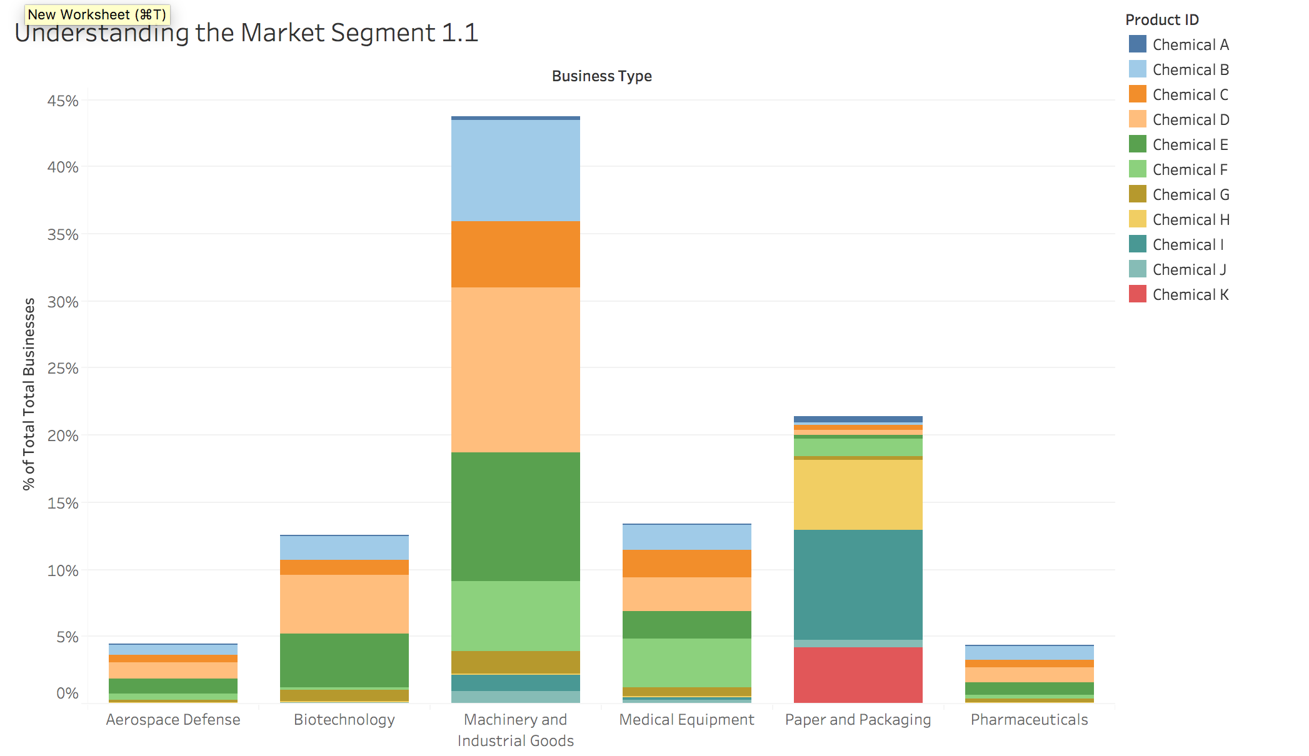
Customer Strategy: Product Distribution per Industry Segment

Slide 4
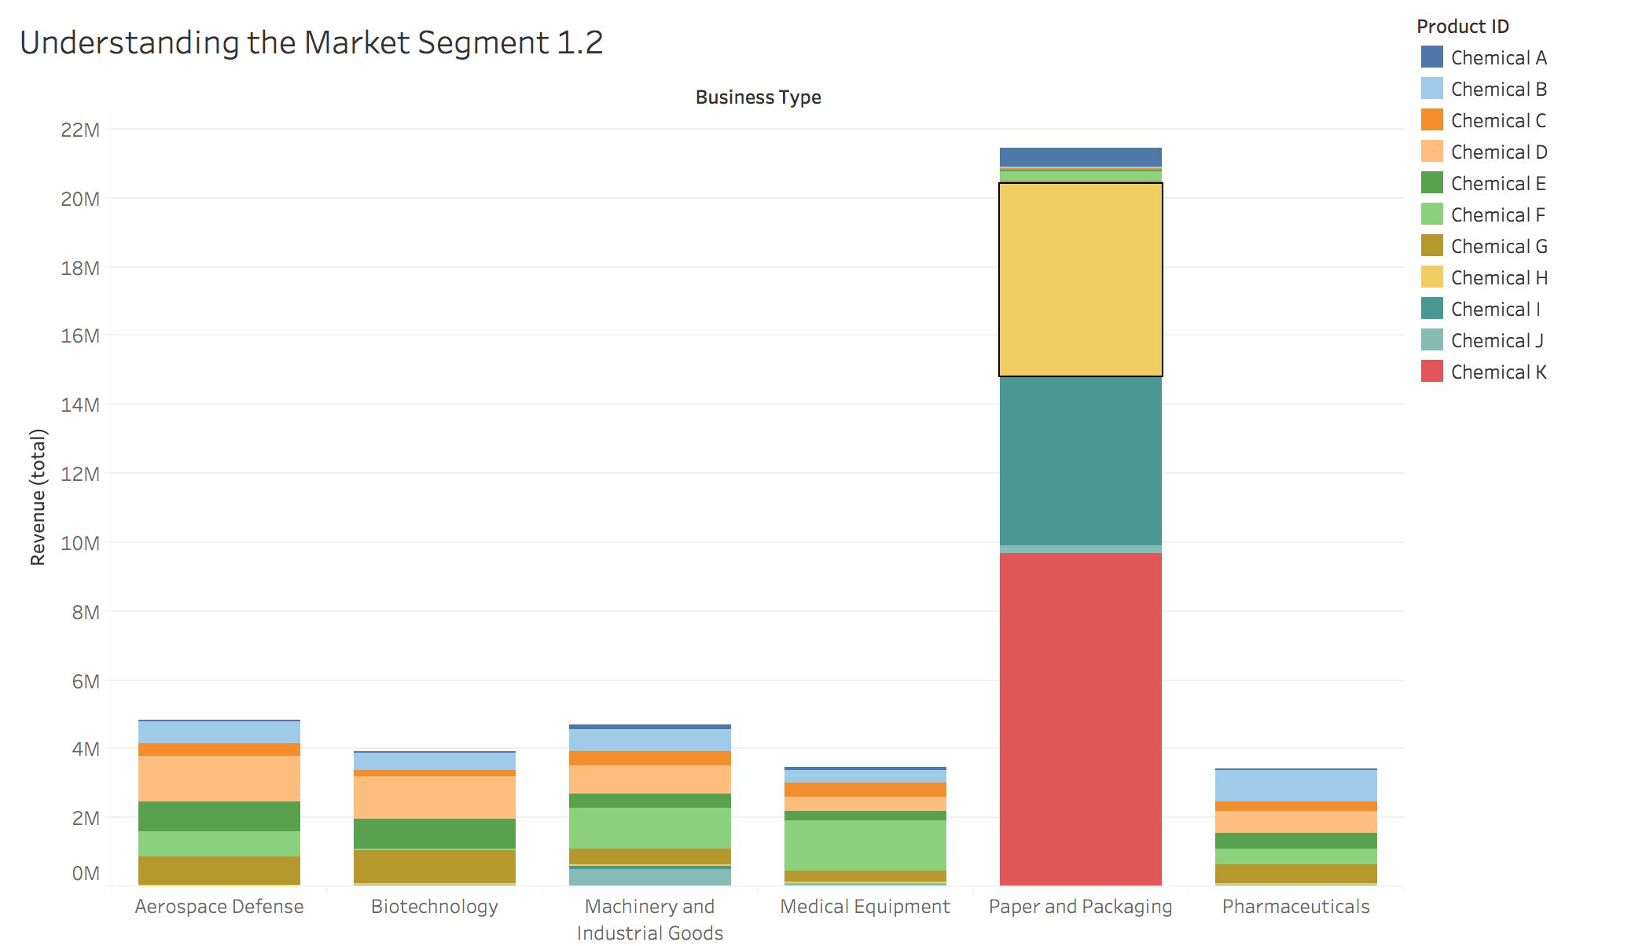
Customer Strategy: Revenue Distribution per Industry Segment

Slide 5
Customer Strategy: Industry Trends in regards to Seasonality

Slide 6
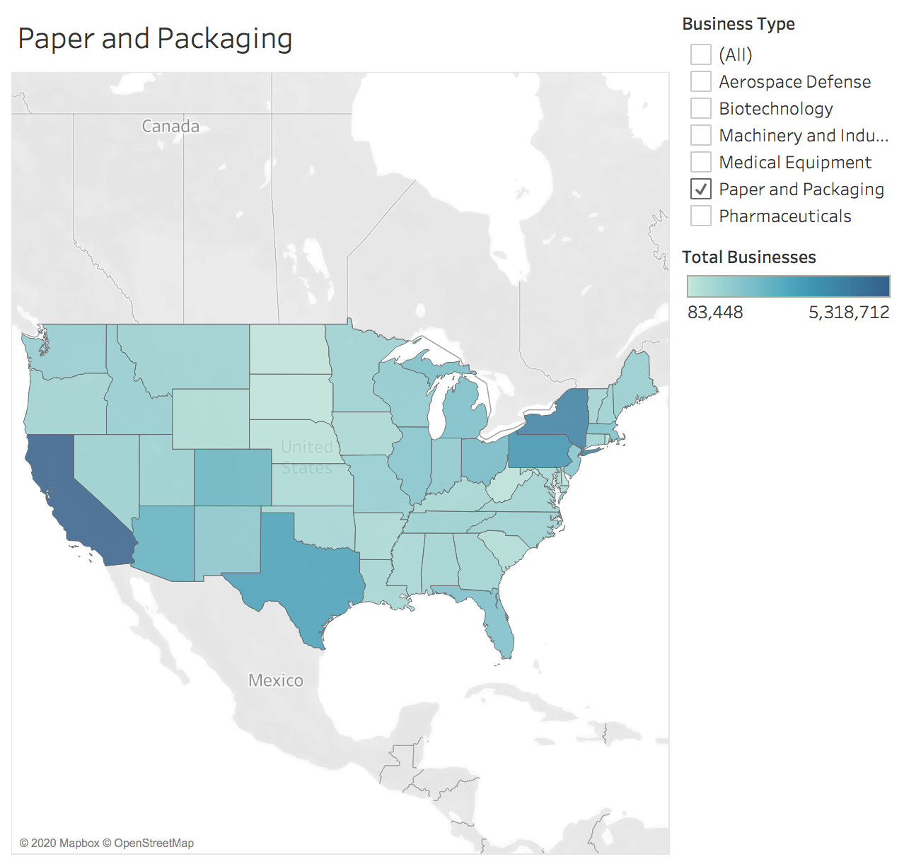
Customer Strategy: Geographic Distribution (Paper and Packaging)

Slide 7
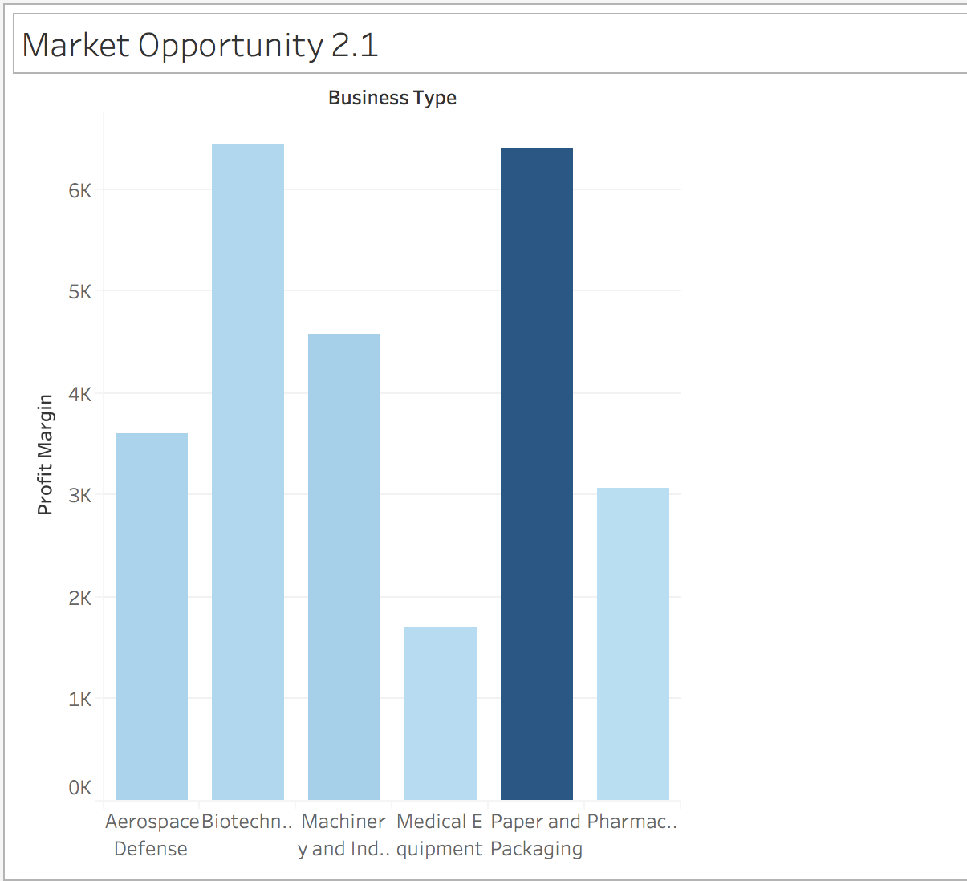
Market Opportunities: Profit Margin Analysis per Industry

Slide 8
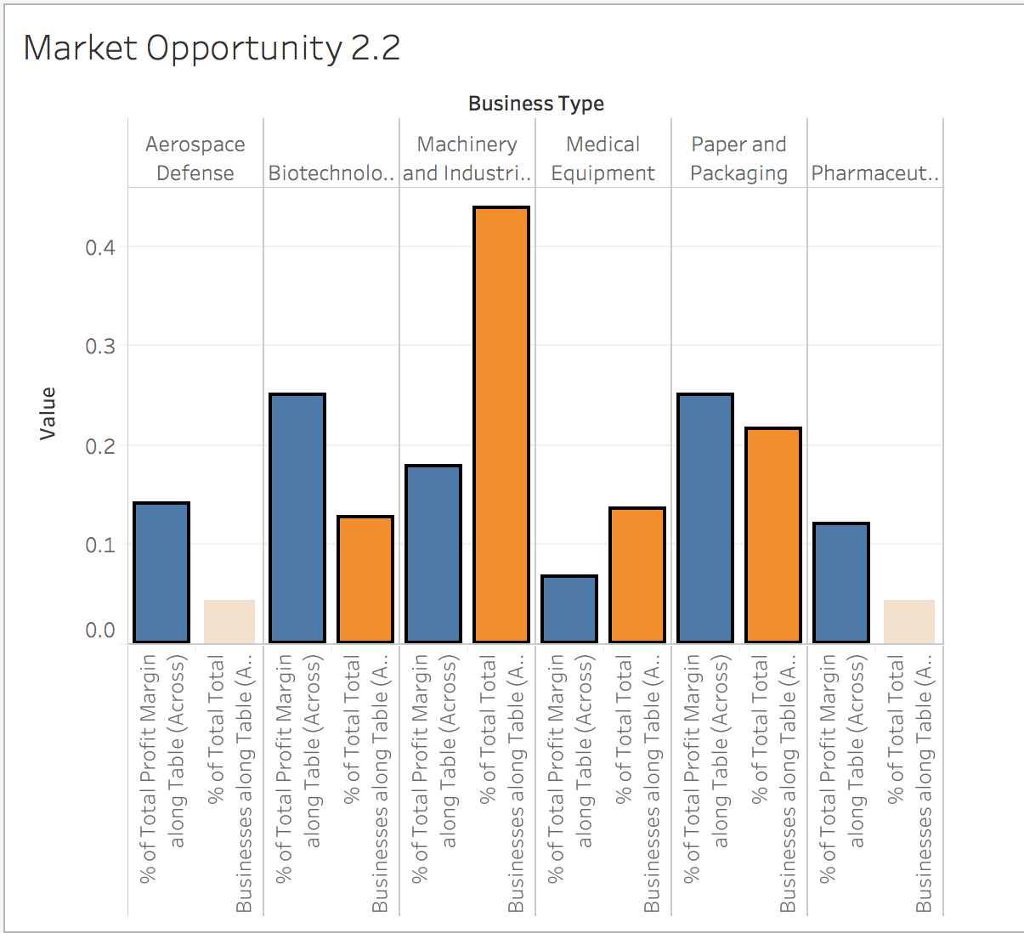
Market Opportunities: Profit Margin % vs Total Business %

Slide 9

Paper and Packaging: Product Popularity

Slide 10
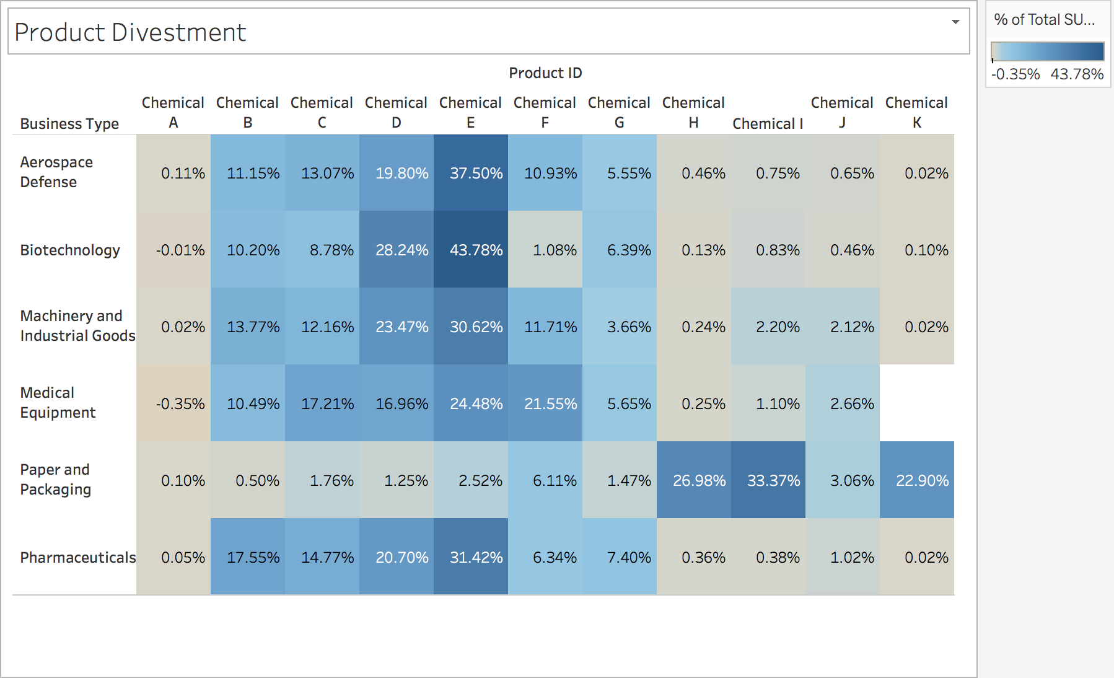
Profit Margin Analysis per Product

Slide 11
Moving Forward
Discontinue
Discontinue Chemical A, J entirely
Divest
Divest from the Medical Equipment industry completely
Reallocate
Reallocate all production of Chemical H, I, K exclusively for the Paper and Packaging Industry
Redistribute
Redistribute resources towards Paper and Packaging, and Biotechnology industries

